Slide 1
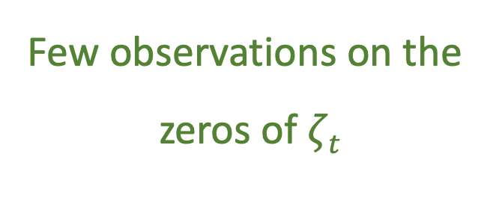
Few observations on the
zeros of $ζt$
December 2021
V1.2 (DRAFT)

Slide 2
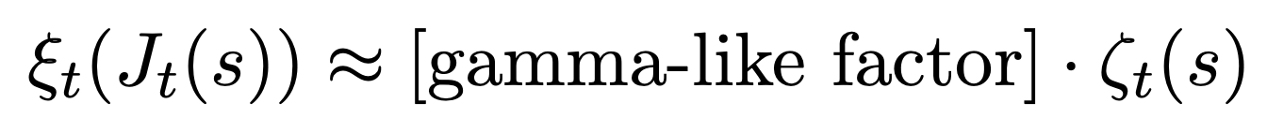
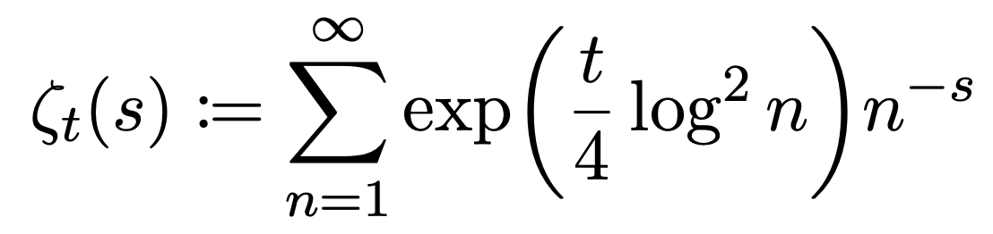
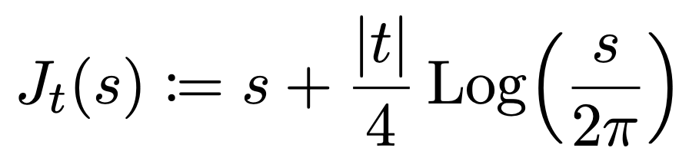
M$apping the zeros of ζt$(s) t$o ξt$(Jt(s))
From this paper by Alexander Dobner: https://arxiv.org/pdf/2005.05142.pdf
The gamma-like factor $≠0, hence$a zero of $ζt$(s) should correspond to a zero of $ξt$($J$_{t}(s))$.$

Slide 3
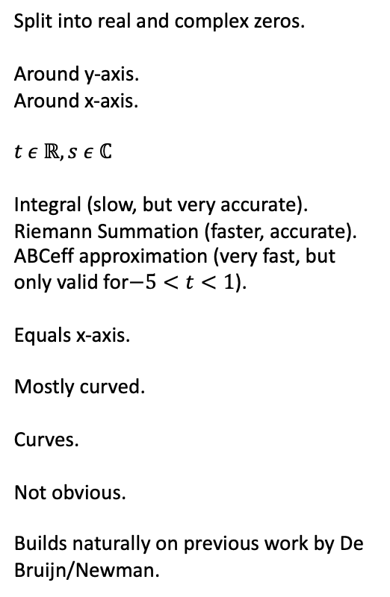
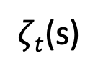
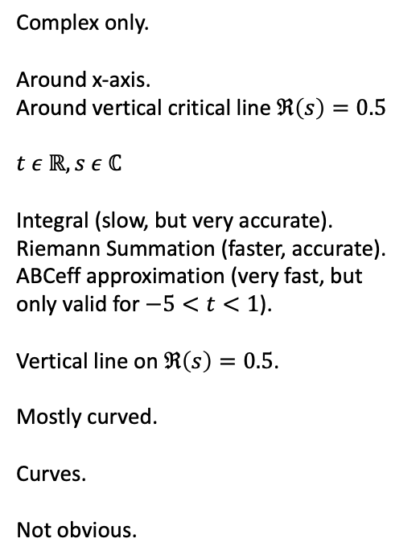
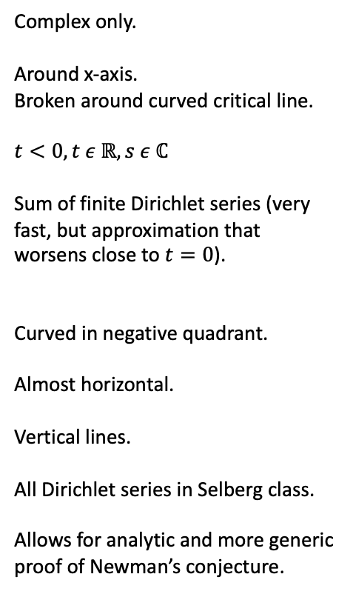
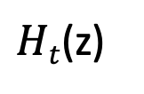

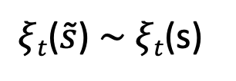

Comparison between the various “world”-views
$ζt$(s)
s $↦\tilde{s}+\frac{|t|}{4}ln{\frac{\tilde{s}}{2π}}$
$ξt$($\tilde{s}$) $\sim$ $ξt$(s)
s $↦\frac{1+iz}{2}$
$Ht$(z)
Types of zeros
x-symmetry
y-symmetry
Domain of validity
Evaluation tool(s)
Critical line
Trajectories of zeros
Journey-end-state of zeros
Extendability
Other
Complex only.
Around x-axis.
Broken around curved critical line.
$$t<0, t ε ℝ, s ε ℂ$$
Sum of finite Dirichlet series (very fast, but approximation that worsens close to $t=0$).
Curved in negative quadrant.
Almost horizontal.
Vertical lines.
All Dirichlet series in Selberg class.
Allows for analytic and more generic proof of Newman’s conjecture.
Complex only.
Around x-axis.
Around vertical critical line $ℜ\left(s\right)=0.5$
$$t ε ℝ, s ε ℂ$$
Integral (slow, but very accurate).
Riemann Summation (faster, accurate).
ABCeff approximation (very fast, but only valid for $−5<t<1$).
Vertical line on $ℜ\left(s\right)=0.5$.
Mostly curved.
Curves.
Not obvious.
Split into real and complex zeros.
Around y-axis.
Around x-axis.
$$t ε ℝ, s ε ℂ$$
Integral (slow, but very accurate).
Riemann Summation (faster, accurate).
ABCeff approximation (very fast, but only valid for$−5<t<1$).
Equals x-axis.
Mostly curved.
Curves.
Not obvious.
Builds naturally on previous work by De Bruijn/Newman.

Slide 4
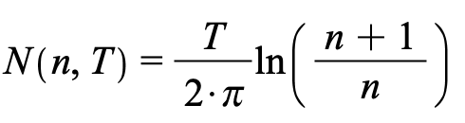
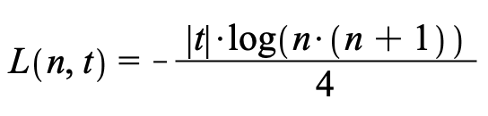
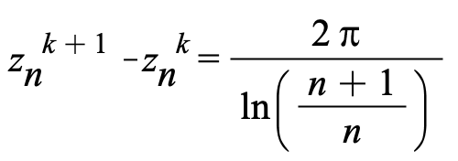
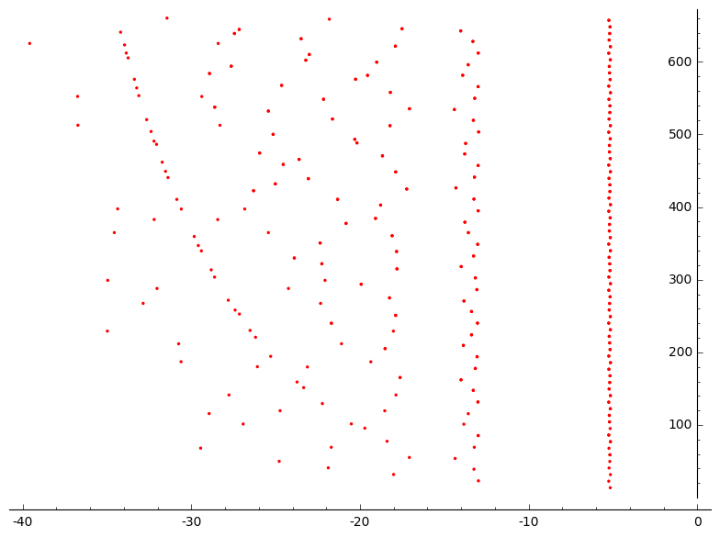
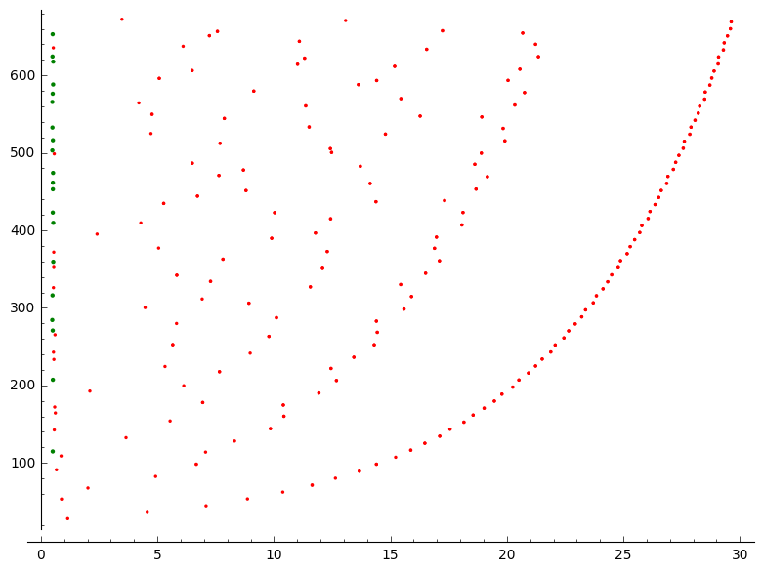
Basics about the zeros of $ζt$(s) (left) mapped to $ξt$(Jt(s)) (right) at t = -30, k = 1..380
Number of zeros line n up to T
Location of line n at time t
Distance of zeros on line n
n=3
n=2
n=1
T = 640
9.064
N(2,640)=41.03
Zeros on the critical line
-18.637
-13.438
L(1,-30)= -5.198
Zeros off the critical line

Slide 5
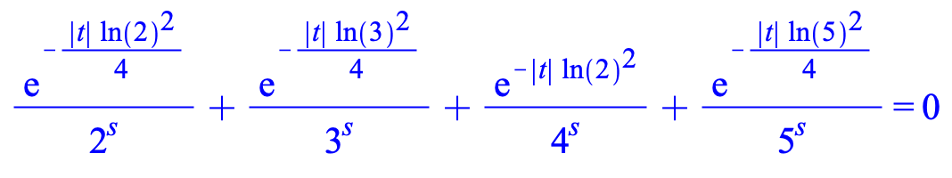
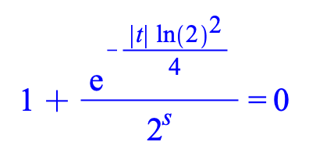
Oscillation of the zeros of $ζt$(s) (left) around lines n at t = -30, k = 1..380
Zeros on the critical line
The oscillations of zeros around the lines n can be simply reproduced and are also explained here:
https://terrytao.wordpress.com/2018/12/28/polymath-15-eleventh-thread-writing-up-the-results-and-exploring-negative-t/#comment-509958
Zeros off the critical line

Slide 6
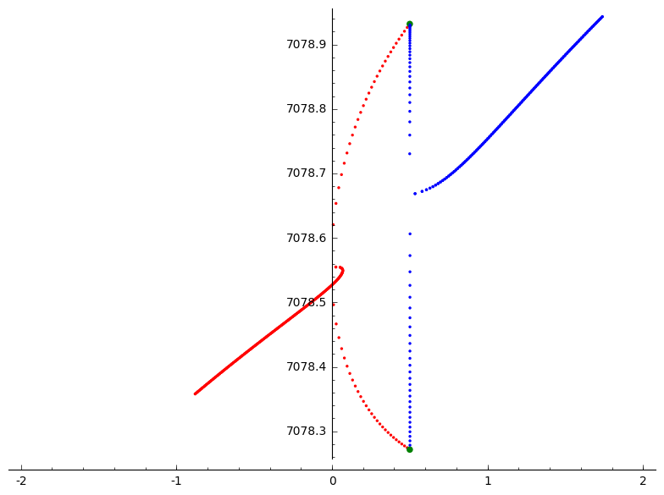

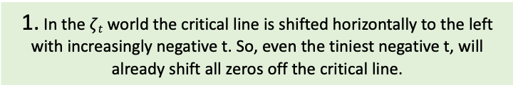


Basics about the zeros of $ζt$(s) mapped to $ξt$(Jt(s)) from t = 0..-1.5 step -0.01 , k = 6791 .. 6792
3. The conjugate of this curve is just the 1-x version mirrored along the critical line.
Collision on critical line
Collision in $ζt$ world
2. Zeros will travel vertically on the critical line until they collide .
4. The “conjugates” of this curve are shown on the next slide.
mapping
1. In the $ζt$ world the critical line is shifted horizontally to the left with increasingly negative t. So, even the tiniest negative t, will already shift all zeros off the critical line.
Zero of $ζt$(s)
Zero of $ξt$(Jt(s))

Slide 7




Basics about the “conjugates” of zeros of $ζt$(s) at t = -30, T = 400 .. 600
“Conjugates” of zero of $ζt$(s)
Zero of $ζt$(s)
1. The critical line in $ξt$(Jt(s) become a curve in the $ζt$(s) world.
2. In the $ζt$(s) world, zeros off the critical line get mirrored along that curve.
Zero of $ζt$(s)
Mirror curve

Slide 8
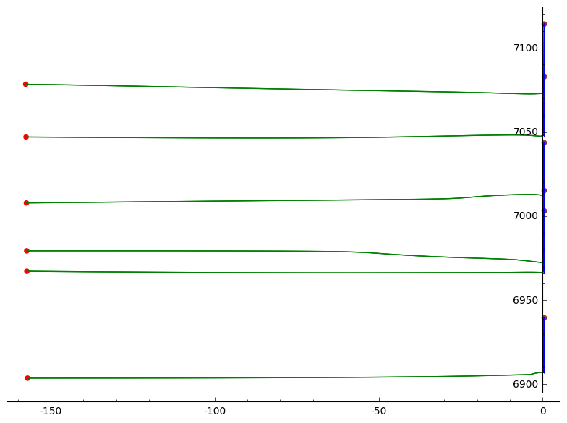




Isolated trajectories of “forever real” zeros, ts = -90, tstep -0.05 , k = 6600..6800
k = 6784, T = 7072.44
k = 6757, T = 7047.95
Zeros on critical line $ζt$(s)
Zeros on critical line $ξt$(Jt(s))
Zero of $ζt$(s) at t = -90
k = 6717, T = 7012.24
Zeros o$f ξt$(Jt(s)) at t = -90
k = 6672, T = 6972.10
k = 6665, T = 6965.79
k = 6600, T = 6907.14

Slide 9
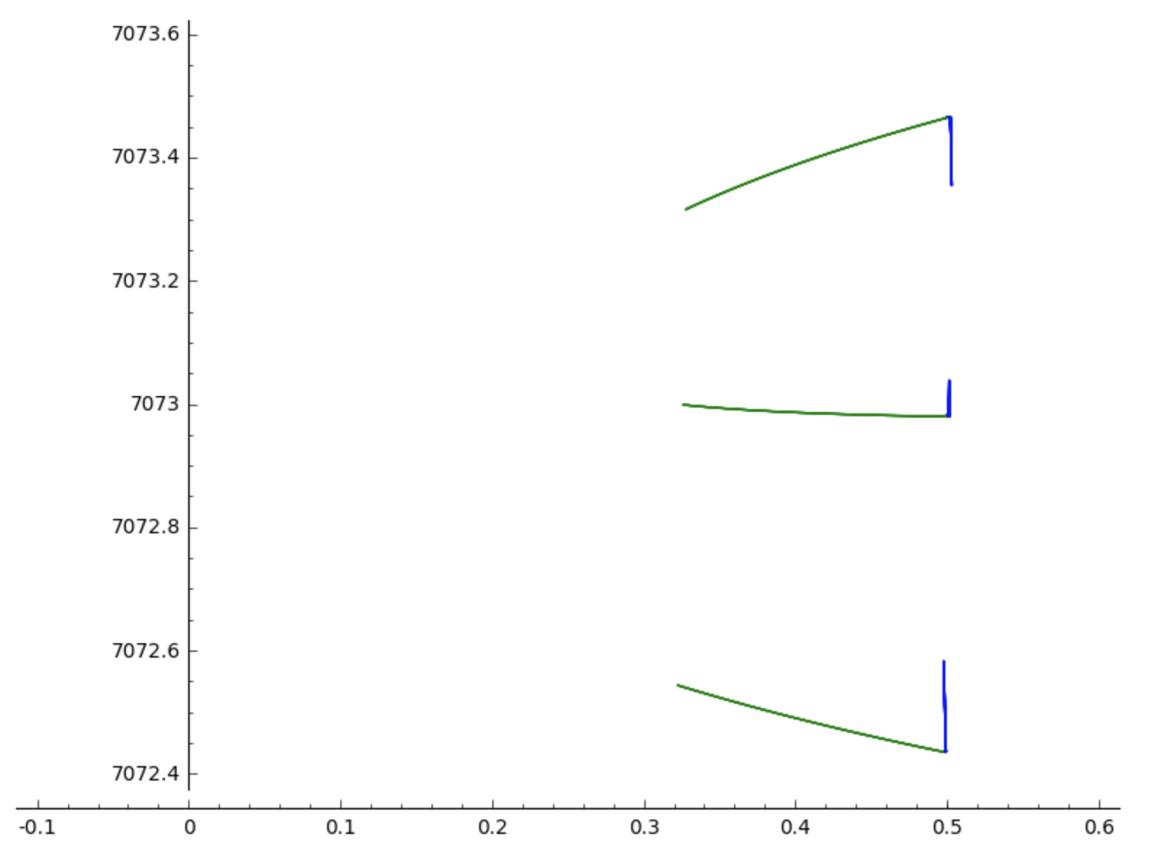
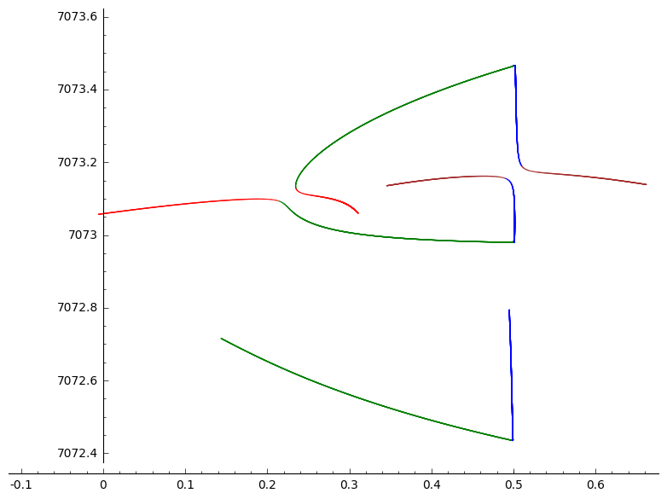
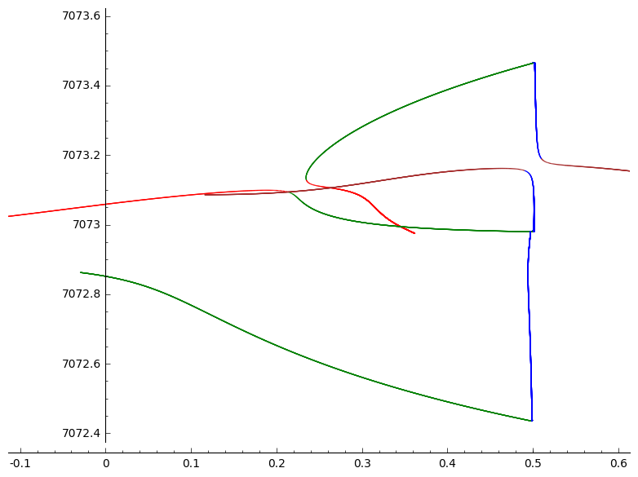
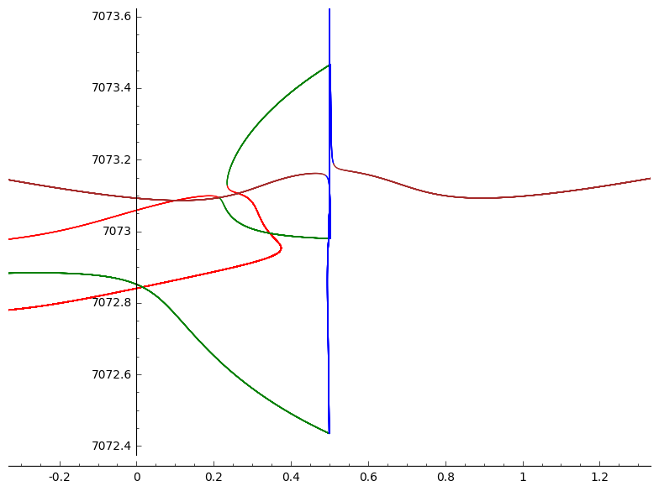




Zoom in on a zero 6784 that stays real forever tstep -0.0001 , k = 6784..6786
6786
6785
Zeros on critical line $ζt$(s)
Zeros on critical line $ξt$(Jt(s))
t = -0.1
6784
t = -0.2
Zeros off critical line $ζt$(s)
Zeros off critical line $ξt$(Jt(s))
t = -0.3
t = -3

Slide 10
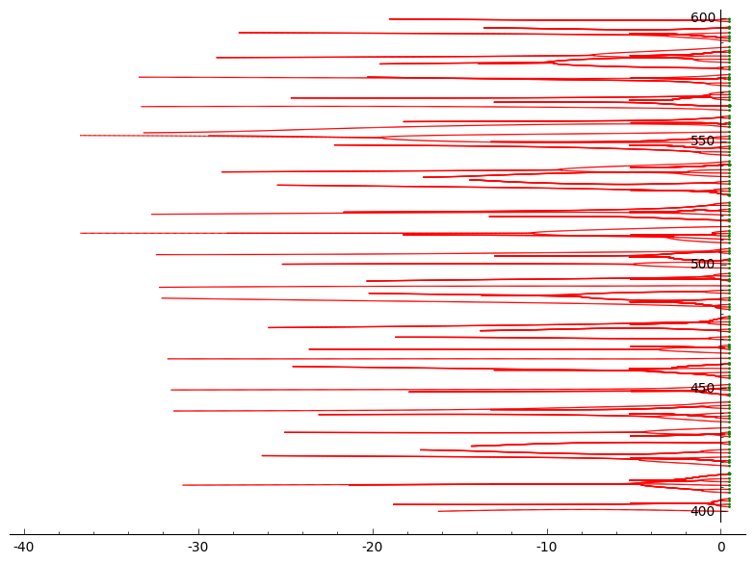
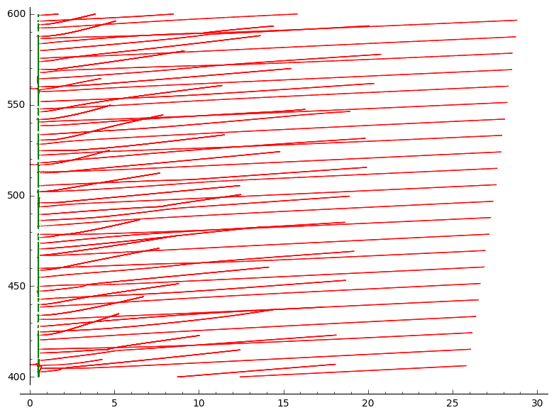
Trajectories of zeros of $ζt$(s) (left) mapped to $ξt$(Jt(s)) (right) from t = 0..-30, y = 400..600
1. Trajectories of zeros off the critical line appear to cluster around horizontal lines. This becomes clearer on later slides.
Zeros on the critical line
Zeros off the critical line
2. Trajectories of zeros off the critical line can cross each other due to a strong y-drift.

Slide 11
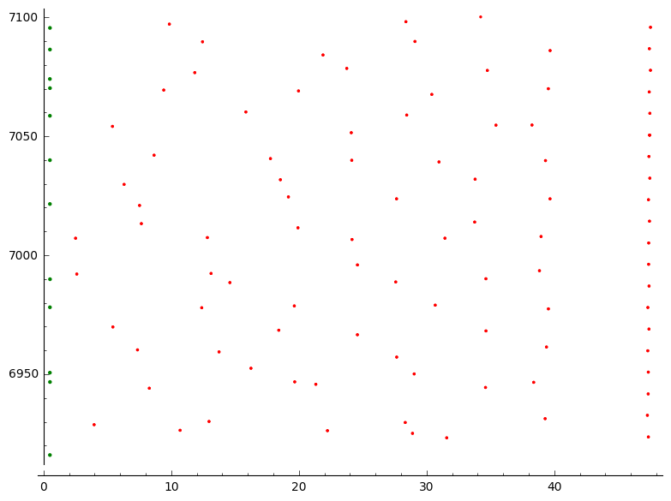
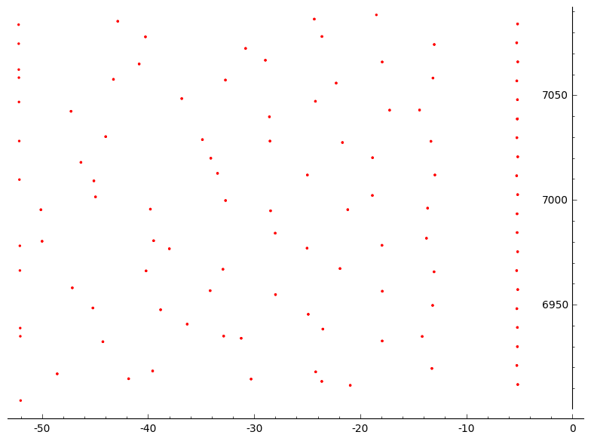
Location of the zeros of $ζt$(s) (left) mapped to $ξt$(Jt(s)) (right) at t = -30, , y = 6999..7050
1. The remaining zeros to be mapped to the critical line have become almost vertical at this height.
Zeros on the critical line
2. Mapping is now clearly recognizable and is almost 1 : 1.
Zeros off the critical line

Slide 12
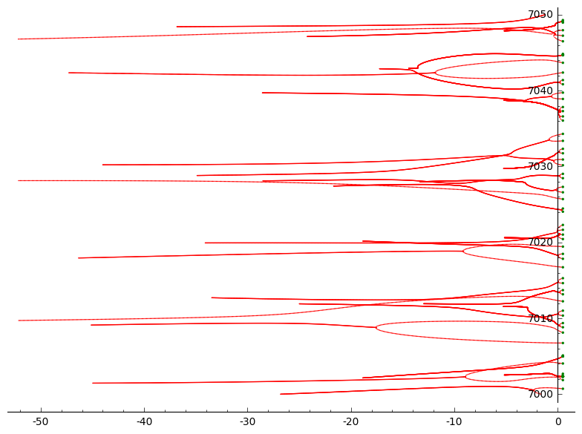
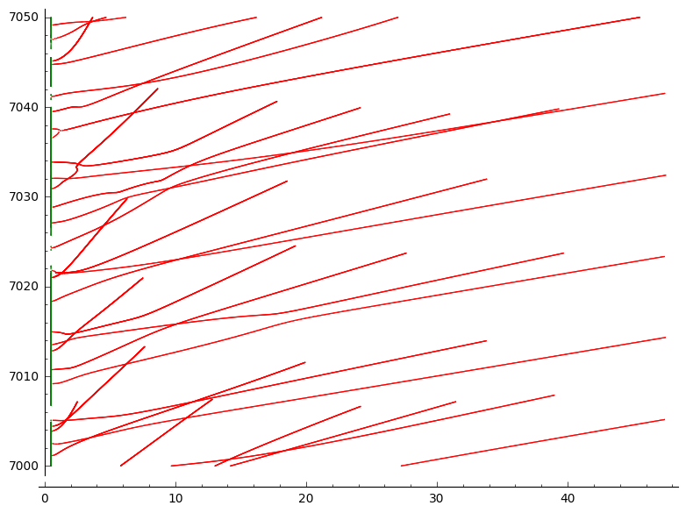
Trajectories of zeros of $ζt$(s) (left) mapped to $ξt$(Jt(s)) (right) from t = 0..-30, y = 6999..7050
1. Zoomed in version around the 6709/10 Lehmer pair. Horizontal clusters can be seen more clearly now.
Zeros on the critical line
2. Gaps on the critical line become visible. Zeros on the line move vertically until they collide. It appears as if certain sections of the critical line are never ‘travelled’ on.
Zeros off the critical line

Slide 13
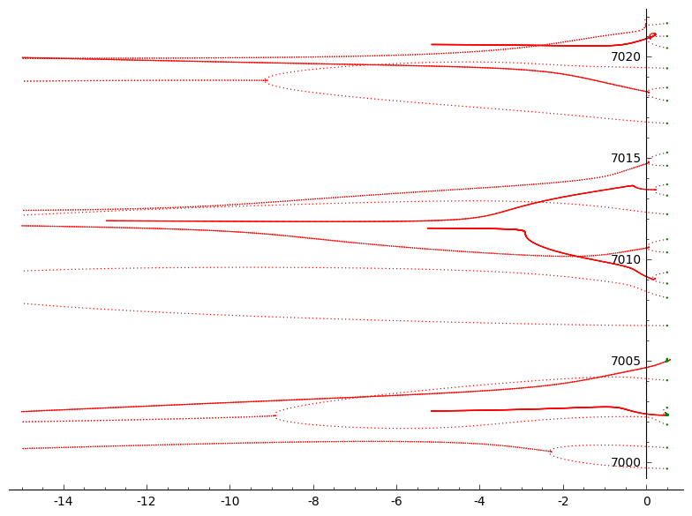
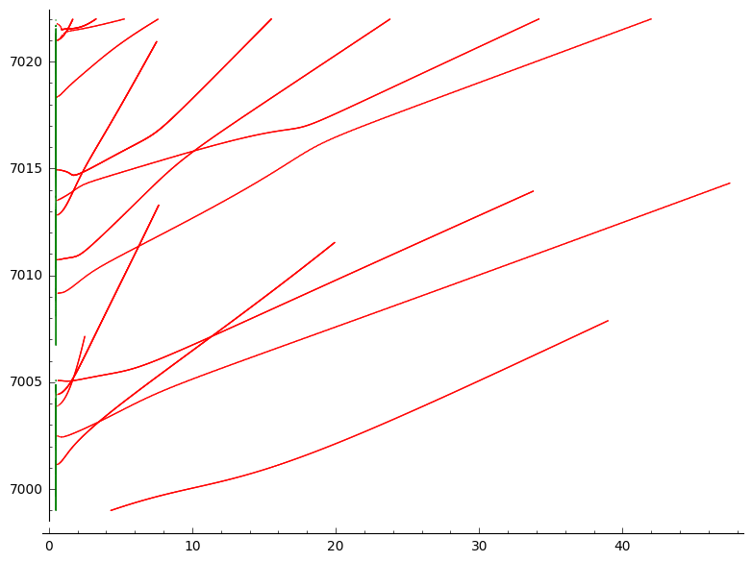

Trajectories of zeros of $ζt$(s) (left) mapped to $ξt$(Jt(s)) (right) from t = 0..-30, , y = 6999..7024
1. A further zoom in around the 6709/10 Lehmer pair. A dotted line implies high speed, the darker red the trajectory, the slower a zero travels.
3. Speed differences are hardly noticeable in this world.
2. In the $ζt$(s) world, zeros appear to travel at a constant speed until they collide. After this they slow down.
Zeros on the critical line
Zeros off the critical line

Slide 14
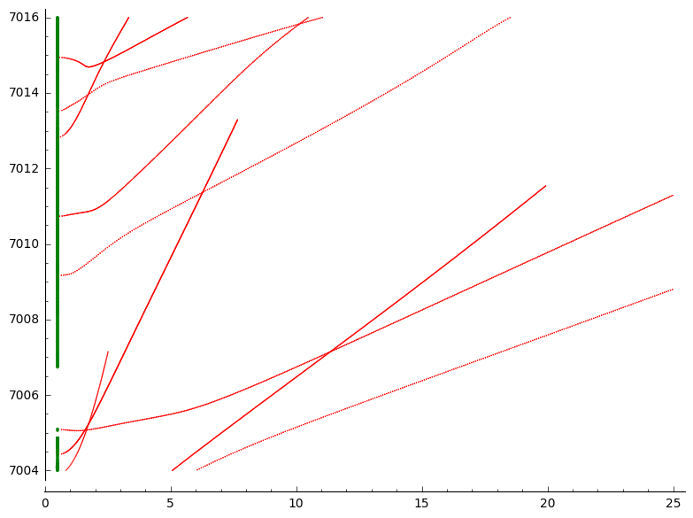
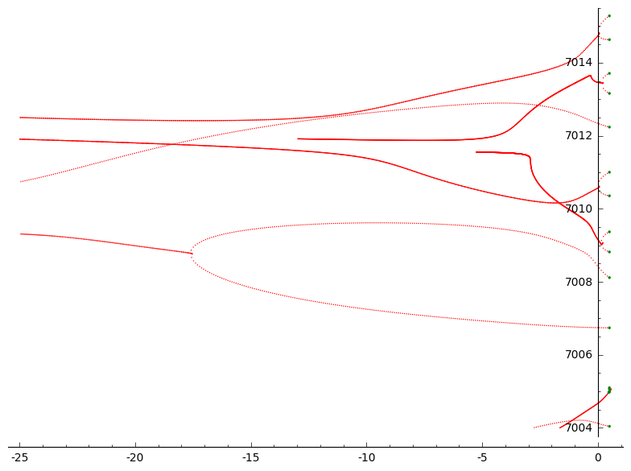
Trajectories of zeros of $ζt$(s) (left) mapped to $ξt$(Jt(s)) (right) from t = 0..-30, y = 7003 .. 7016
1. Zoomed in a bit further.
7009.3677507071490552
7008.8174736332548758
7008.1147420573949079
7006.7396623839491133
7005.1005646726467216
7005.0628661749205814
7004.0437234993286769
7002.6915086805398254
2. This gap on the critical line seems to be induced by the 6709/10 Lehmer pair. This seems to make sense form looking at the t=0 zero locations and how these collide.
Zeros on the critical line
Zeros off the critical line

Slide 15
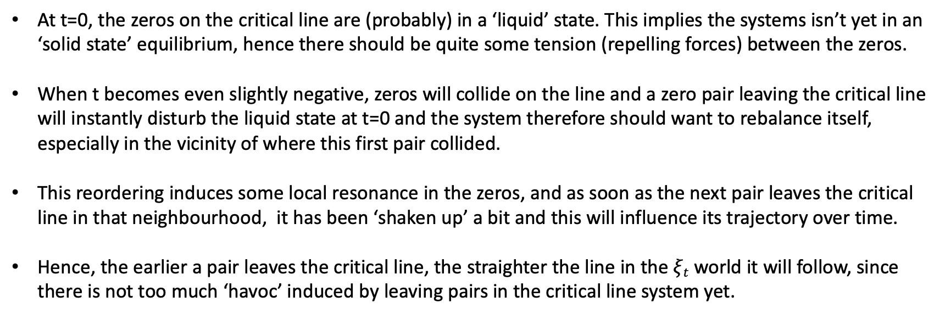
Wilder thoughts
At t=0, the zeros on the critical line are (probably) in a ‘liquid’ state. This implies the systems isn’t yet in an ‘solid state’ equilibrium, hence there should be quite some tension (repelling forces) between the zeros.
When t becomes even slightly negative, zeros will collide on the line and a zero pair leaving the critical line will instantly disturb the liquid state at t=0 and the system therefore should want to rebalance itself, especially in the vicinity of where this first pair collided.
This reordering induces some local resonance in the zeros, and as soon as the next pair leaves the critical line in that neighbourhood, it has been ‘shaken up’ a bit and this will influence its trajectory over time.
Hence, the earlier a pair leaves the critical line, the straighter the line in the $ξt$ world it will follow, since there is not too much ‘havoc’ induced by leaving pairs in the critical line system yet.

